Slide 1
WA Community College Veterans Health IT Initiative
Outreach to Service Members & Veterans
Jason Alves, WDVA Program Manager Vet Corps & Veteran Conservation Corps
Peter Schmidt, Project Director, Veterans Training Support Center

Slide 2
I. Transitioning Servicemembers
Army Career Alumni Program (ACAP)
  Army & USAF
Transition Assistance Program (TAP)
  Navy, Marines & Coast Guard
Education Office on base
Navy College – Clearing House for colleges and education opportunities on base

Slide 3
II. Veterans
Student Veteran Associations/Vet Corps
Certifying Officials/College Professionals
Vet Centers
Disabled Veterans Outreach Program (DVOP)
Local Veteran Employment Representatives (LVER) http://dvoplverlocator.nvti.ucdenver.edu/
https://www.nrd.gov/viewResource?id=14201121
Regional Veteran Employment Representative (RVER)
Family Readiness Group – USAF & Army
Education Officer – Guard/Reserve Units
VFW, American Legion, WWP, DAV, VVA, WDVA, VTSC

Slide 4
III. Social Media - Marketing
Facebook
Linked-in
Digital signage
Digital Story Telling - http://www.youtube.com/watch?v=dKZiXR5qUlQ
YouTube
Brochure - Crosswalk – Specialty + civilian counter part, cost for training, length, salary

Slide 5
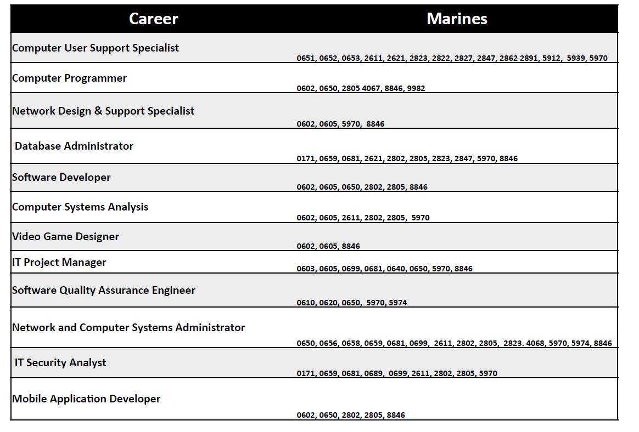
Eligible Marines

Slide 6
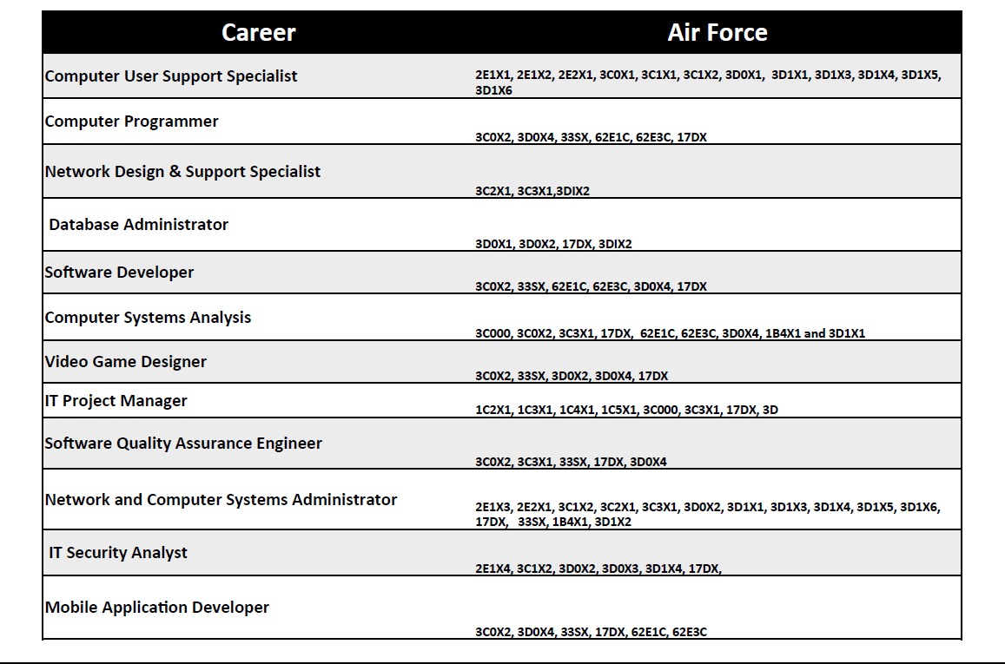
Eligible Air Force

Slide 7
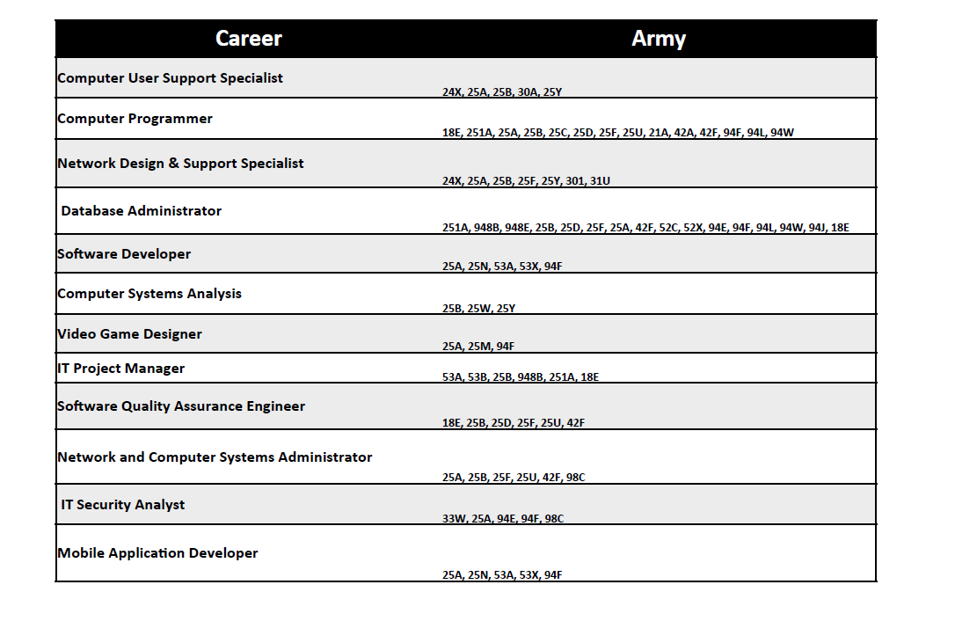
Eligible Army

Slide 8
IV. Cultural Competence
How would a Veteran or a family member know whether you and your department is Vet-aware or Veteran friendly?
What factors would prevent a Veteran from self-identifying to you, or your department?
How comfortable are you working with military service members and Veterans?
How does the veteran identify with their Rate/MOS/ AFSC?

Slide 9


Thanks for your interest
To
Better Serve, Those Who Have Served.

